Slide 1
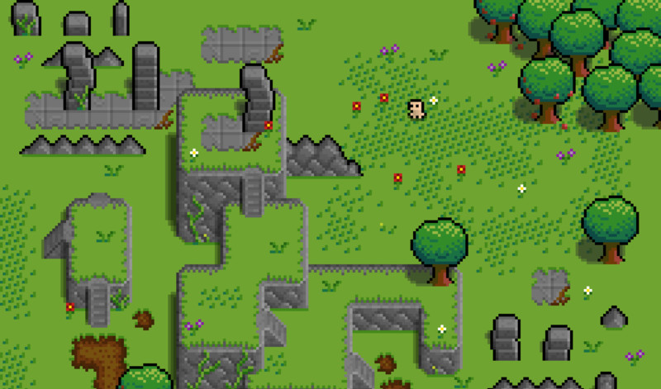

Green Sky Games
1 Bidhan / 2 Todd / 2+ Alex / 3 Mark / 4 Shan / 5 Hengyi / 6 Liz

Slide 2

01
Game Story
You could enter a subtitle here if you need it

Slide 3
BREAKING RED

Slide 4
OUR GOALS
Story
Combat
Scenery
A cohesive story that follows the main character, a parody of Little Red Riding Hood.
Red will be able to fight her foes in the forest wielding her trusty walking stick.
The forest of Red’s youth will be an explorable scene where the forest denizens hide.

Slide 5

The Story of Breaking Red
“Once upon a time, Little Red Riding Hood visited her Grandmother’s house, only to find her… murdered. Who could have committed such a heinous act in the forest that Red grew up in?”
“No longer the scared girl of her youth, it’s up to Red to find out who killed Grandmother and bring them down.”

Slide 6
02
About Us
Hello, from Green Sky Games!

Slide 7
OUR TEAM
Bidhan
Todd
Alex
TL1
TL2
TL2+
Mark
Shan
Hengyi
Liz
TL3
TL4
TL5
TL6

Slide 8
03
Storyboard
You could enter a subtitle here if you need it

Slide 9
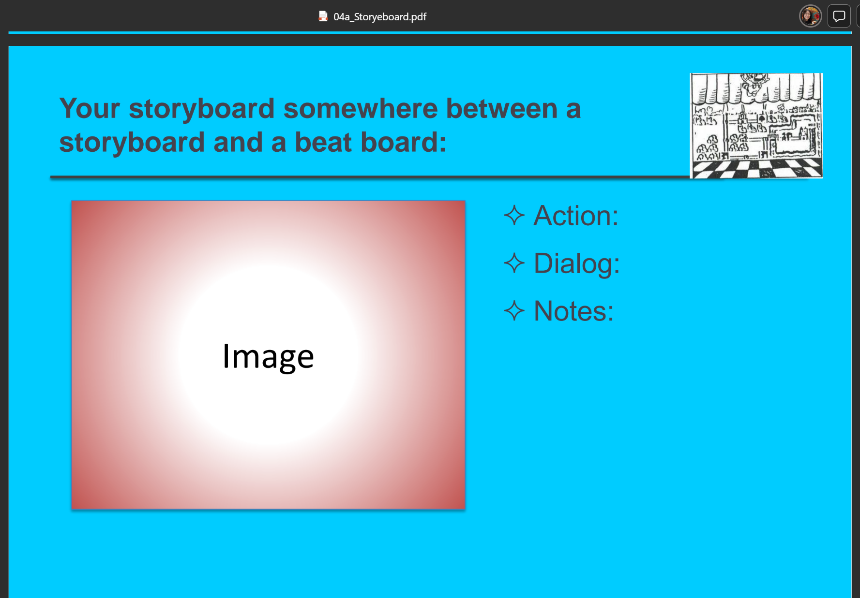
Scene 1: Main Menu
Action:
Selection of starting
main gameplay
Dialog:
None
Notes:
Background music

Slide 10
Scene 2: Character creator
Action:
Choose different options for character stats
Dialog:
None
Notes:
Background music

Slide 11
Scene 3: Prologue to game
Action:
Full screen dialogue that displays the start to the storyline.
Dialog:
Text on screen.
Notes:
Simple presentation of the prologue of the story.

Slide 12
Scene 4:Load tutorial scene
Action:
Navigation and combat controls are shown on screen and a direction is given to the first NPC encounter.
Dialog:
Text and arrows written on the ground.
Dialogue boxes had with the tutorial NPC.
Notes:
The first encounter is designed to demonstrate combat to the player before they move on.
All levels from this point onward can be returned to at will.

Slide 13
Scene 5: Load forest scene
Action:
Moving through the passageway allows the player to enter the next area.
Exploring this area will reveal the next NPCs
Dialog:
Multiple NPCs will be available for dialogue interactions.
Notes:
Several of these NPCs will be able to provide clues to the player.
These clues may not be obvious and must be read from the text.

Slide 14
Scene 6: Load lake scene
Action:
Navigation through the forest and around the lake to find additional NPCs.
Dialog:
Interacting with the NPCs placed around the lake.
Notes:
The lake will have thematic NPCs that fit the setting.

Slide 15
Scene 7: Load Lumberyard
Action:
An isolated area with only one NPC.
Dialog:
Speaking with the NPC about his task in the forest.
Notes:
Finding this location creates a dead end in the forest for exploration.

Slide 16
Scene 8: Victory screens
Action:
Full screen dialogue box appears after win conditions are met.
Dialog:
Text on screen that explains ending achieved by the player.
Notes:
Three possible endings are planned depending on what has been achieved.

Slide 17
04
Data Flow Diagrams
You could enter a subtitle here if you need it

Slide 18
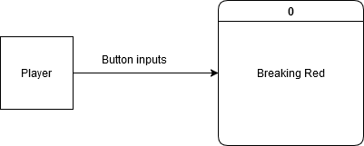
CONTEXT DIAGRAM

Slide 19
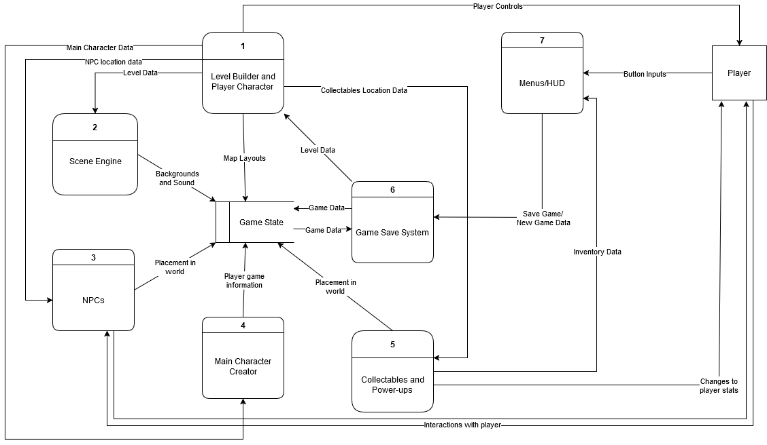
DIAGRAM 0

Slide 20
05
Global Use Case
You could enter a subtitle here if you need it

Slide 21
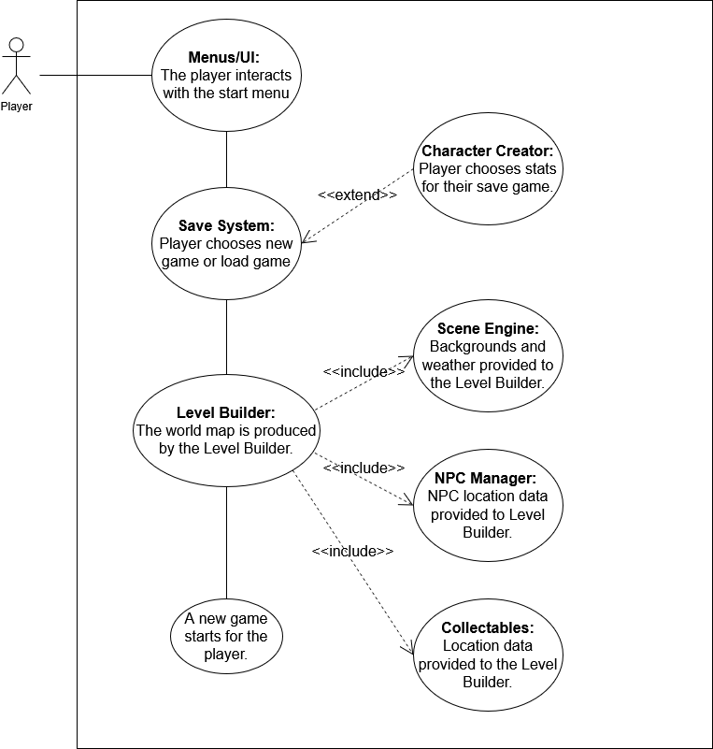
GLOBAL USE CASE

Slide 22
06
Individual Use Case
You could enter a subtitle here if you need it

Slide 23
Liz– feature

Slide 24
Liz Use Case

Slide 25
Bidhan – feature

Slide 26
Bidhan Use Case

Slide 27
Mark – feature

Slide 28
Mark Use Case

Slide 29
Alex– LEVEL LOADER

Slide 30
Alex Use Case

Slide 31
Hengyi – SCENE ENGINE

Slide 32
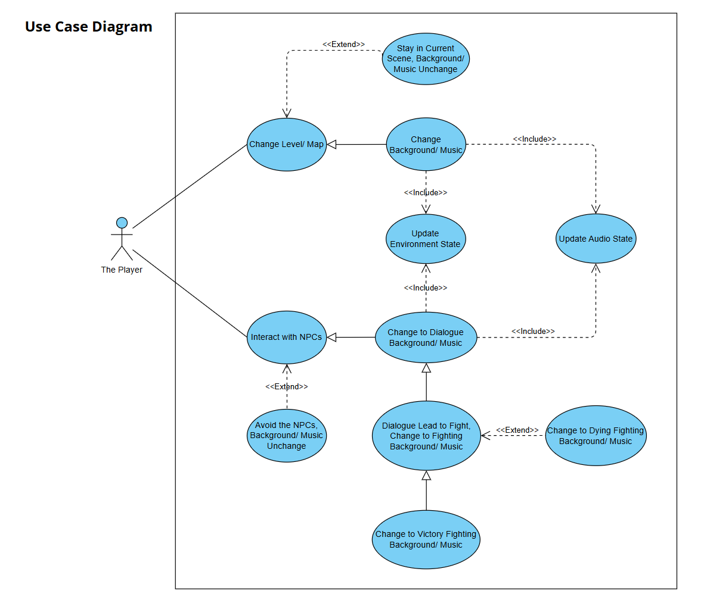
Hengyi Use Case

Slide 33
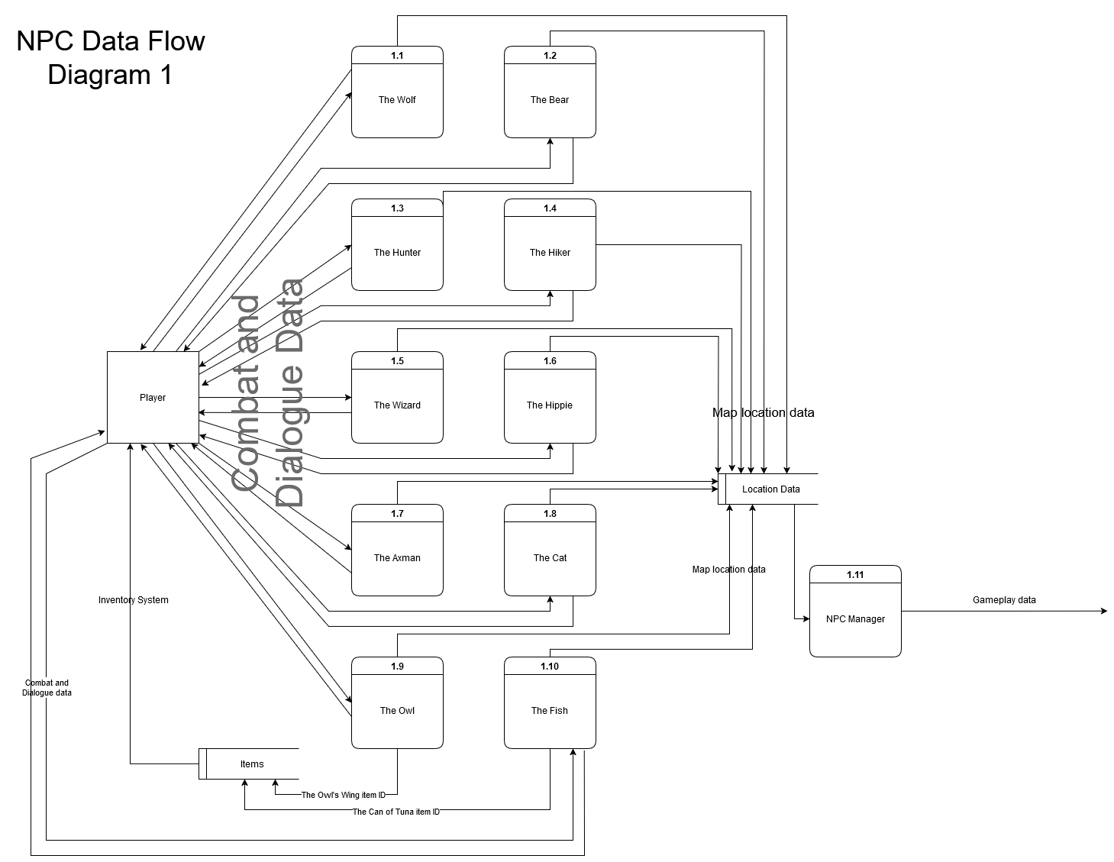
Todd – NPCs/Story Diagram 1 TL2+

Slide 34
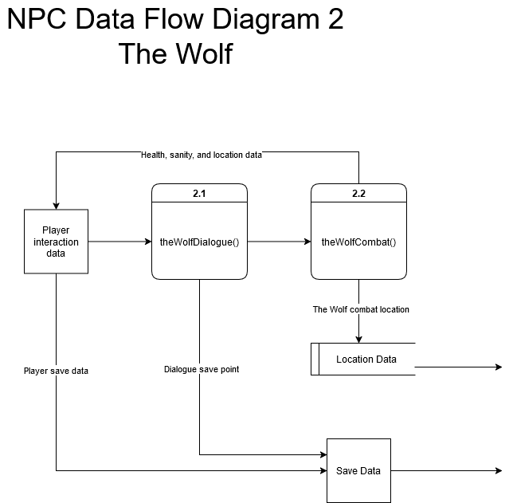
Todd – NPCs/Story Diagram 1 TL2+

Slide 35
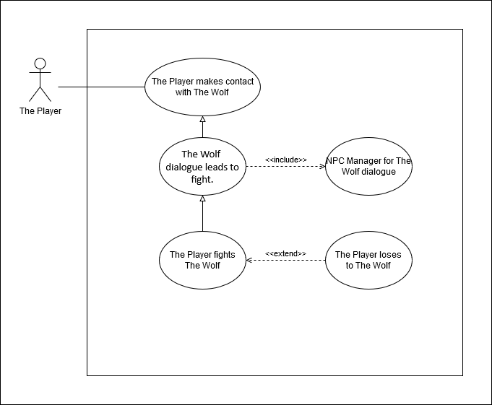
Todd - NPCs/Story Use Case TL2+

Slide 36
Todd – NPCs/Story Overview TL2+
Complexity: 9/10
Priority: 2
Though relatively complex due to creating a unique dialogue system that will be able to handle the flow of the story, the NPCs and story are lower priority than crucial systems such as the ability to move and attack.

Slide 37
Shan – feature

Slide 38
Shan - Use Case

Slide 39
THANKS!
?
Any Questions?

